Slide 1
Function Basics
CS 201, Summer 2013

Slide 2
ADDITIONAL READING
Functions
  Chapter 3 of Pearson textbook
  http://www.learncpp.com/cpp-tutorial/71-function-parameters-and-arguments/

Slide 3
What are Functions?
Functions are a way to delegate tasks to other parts of the program – and give it a name to identify what that task is doing.
A function gets called from another location. A function may or may not return data to that caller.
  If a function returns data, it will return a specific data-type like int, float, string, etc.
  A function can only return one variable in C++. However, there are ways to pull more data out from a function, but that will be covered when we get to references.

Slide 4
What are Functions?
You may be using functions when you load a library from somewhere else – Such as generating a random number, opening a file to read, etc.
You can also write your own functions.
A function can receive arguments from the caller. These arguments are variables that are available to the caller and the function will work with this data.

Slide 5
What are Functions?
int Sum( int num1, int num2 );
When we declare a function, we must specify:
  Return type (Type of data it will return)
  Function name
  Parameter list (Can contain no parameters, or many parameters)
    Parameters must also specify a data-type. With the Sum function, it will take two integers.
The line above is a function header
  Includes return type, function name, and parameter list.

Slide 6
Parameters? Arguments?
Parameters are the list of variables in a function it is expecting to receive and work with.
  The function doesn't know what the values of these parameters will be, but it must receive them.
Arguments are the variables passed to the function when it's called from elseware.
  These variables have probably been initialized with values and are being passed to the function. These may be variables in main().

Slide 7
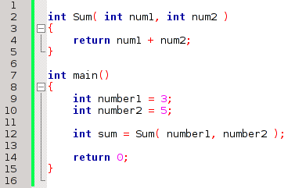
Parameters? Arguments?
Parameters are part of the Function Definition
Arguments are the variables passed into the function call.

Slide 8
Parameters? Arguments?
The name of the parameters do not need to match the name of the arguments being passed in – the function helps you keep the functionality generic so you could use it anywhere.
The arguments could be, for example, “shipmentOfCookies1” and “shipmentOfCookies2” - they don't need to be “num1” and “num2”.

Slide 9
Sample Functions
Functions can have any data-type for its return value that could be created as a variable...
  int GetStudentCount( Classroom room );
  float GetPricePlusTax( float taxRate );
  string FormatName( string first, string last );
  bool IsFileOpen( ofstream outfile );
This also includes objects (ie, classes):
  Cookie BakeNewCookie( Recipe recipe );
Additionally, functions can return void when it will have nothing to return:
  void DisplaySelectionMenu();

Slide 10
Why use functions?
Functions are a good way to keep your programs modular – separate functionality into its own chunks.
Say you have a lot of assignments where you have to load data out of a text file.
  You could write one “text file data reader” function and reuse it over and over.

Slide 11
Declaring a function
A function declaration is simply writing the function header and not including any of the function body.
You can declare a function above main() and then define it below main()
When you're writing classes in C++, you generally keep the function and class declaration in header (.h) files, while function definitions go in source (.cpp) files.

Slide 12
Defining a function
A function definition includes the function header and the function's contents, enclosed within curly braces { }.
This is the actual functionality carried out when the function is called.

Slide 13
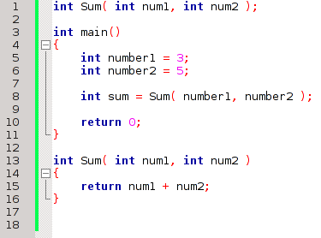
Declaring a function
Function Declaration – now the compiler knows we're going to use a function called “Sum”.
Function Call – The program jumps to the function to execute, then returns back to this position afterward.
Function Definition – This defines what the function does.

Slide 14
Calling a function
Functions can be called from within main(), within other functions (note: main() is a function), and from within class functions.
A function can call itself – this is called recursion, and can be used to perform the same functionality over a series of data. (More on this later)

Slide 15
Returning data
In Python, you can return multiple variables or data from a function. You can only return one in C++ via the return statement (There are other ways to achieve the same thing, though).
void functions can return with no data. You can use this to return from a function early if you know there is nothing left to do.
Anything being returned needs to match the function's return data-type.

Slide 16
Scope
Scope refers to where a variable can be used.
If a variable is declared in a function, it can only be used within that function, unless it's passed to another function as an argument.
Similarly, if a variable is declared within an if statement or loop, it can only be used within that statement or loop.

Slide 17
Scope
Functions, if statements, and loops have their bodies enclosed in curly braces { }.
If a function is declared within these braces, it is inside that scope.
Once it leaves the scope (ie, the } ending the statement), the variable will cease to exist.

Slide 18
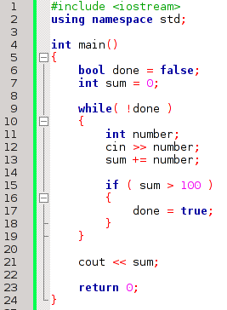
Scope
sum is inside
the scope of main()
number is inside the
scope of the while loop
number gets destroyed at this point
We can access sum, but we
would get a compile error if
we tried to access number.

Slide 19
Scope
Variable names cannot be reused within the same scope, but they can be reused in different scopes.
  Different functions can both have a “userChoice” variable declared.
It is best practice to keep variables at the most restrictive-possible scope.
  No unused variables floating around in a place they are not needed.

Slide 20
Variable types
When a variable is declared within a function (including main()), it is local to that function.
If a variable is declared outside of any functions, it is global and can be used anywhere.
  This is widely regarded as bad practice.
    Don't have tight control over your program;
    Can't make sure a variable has a value you're expecting, because anything can access it!

Slide 21
Variable types
Global Variables
  You might use global variables for “config”-type data that would be needed in the whole program.
  If possible, make these const!
    const variables are unchangeable – fixed at one value for the entire program.

Slide 22
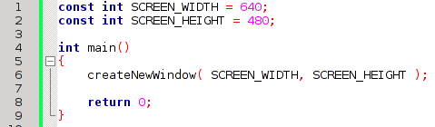
Variable types
This is a sample of using some global const variables. A program might need to know its resolution throughout in different places.
(createNewWindow isn't an actual function, but if you were using a 3rd party graphics library, you could do something like this).

Slide 23

Variable types
Of course there are usually also Object Oriented ways to achieve things, WITHOUT global variables.
This could be a “System” class that handles screen resolution data & functionality.

